Slide 1
Responsive Design in Email Marketing

Slide 2

Introduction
Responsive design ensures emails look good on all devices, from desktops to mobile phones.
Importance:
Enhances user experience
Increases engagement .
Notes:
It involves creating flexible layouts, images, and styles that adapt to the screen size and orientation of the device being used.
Importance
by providing a seamless reading experience across different devices.
by making content easily accessible and visually appealing on any device

Slide 3
Importance of Responsive Design in Email Marketing
Increasing Mobile Usage:
Statistics on email opens on mobile devices:
60% of emails are opened on mobile devices.
2.2 billion by the end of 2024.
Challenges of Non-Responsive Emails:
Poor user experience on mobile devices
High bounce rates and low engagement
Potential for lost revenue
Benefits of Responsive Email Design:
Improved user experience
Higher engagement rates
Notes:
Emails that are not optimized for mobile can be difficult to read and navigate.
Users are likely to abandon emails that don’t display correctly on their device.
Poorly designed emails can lead to lost sales opportunities and reduced customer loyalty.
Benefits
Ensures emails are readable and navigable on all devices.
Responsive emails tend to have higher click-through rates (CTR) and lower bounce rates.

Slide 4
Key Elements of Responsive Email Design
Flexible Layouts:
Fluid grids and flexible images:
Use percentage-based widths for containers and images.
Ensure images are scalable and maintain aspect ratios.
Media Queries:
Adapting styles based on device characteristics:
CSS media queries allow you to apply different styles depending on the screen size and resolution.
Example: @media only screen and (max-width: 600px) { ... }
Prioritizing essential information:
Focus on delivering the most important content first.
Use clear, concise text and strong calls to action (CTAs).

Slide 5
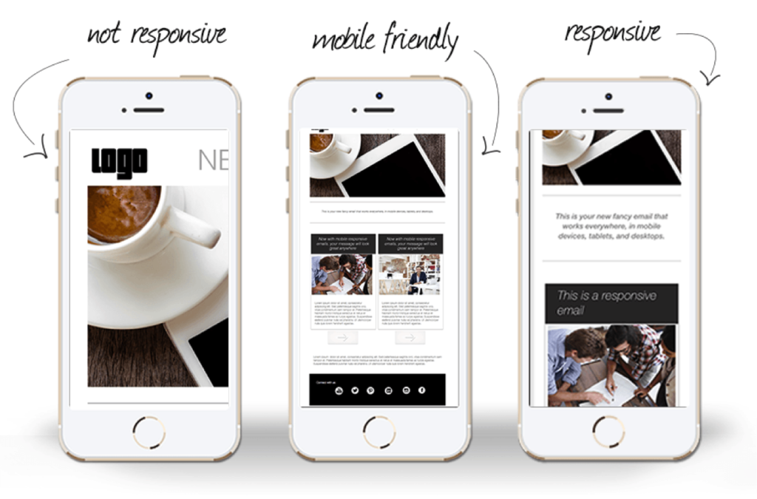
Responsive Design

Slide 6
Flexbox for Responsive
CSS layout module for flexible and responsive layouts.
Basic Flexbox Properties
display: flex; - Defines a flex container.
flex-direction: row | column; - Direction of flex items.
justify-content: center | space-between | space-around; - Horizontal alignment.
align-items: center | flex-start | flex-end; - Vertical alignment.
Advantages of Using Flexbox:
Simplifies layout design with less code.
Provides better control over alignment and spacing.
Easily adapts to different screen sizes.

Slide 7
Media Queries for Responsive Design
CSS technique to apply styles based on device characteristics.
Basic Media Query Syntax:
@media only screen and (max-width: 600px) { ... }
Advantages of Using Media Queries:
Offers precise control over layout changes at various screen sizes.
Enhances design adaptability for different devices.
Ensures consistent appearance across all devices.

Slide 8
Images and Graphics in Emails

Slide 9
Images in Emails
Embedded Images: Included directly in email HTML using <img> tags with src attribute.
Hosted Images: Stored on a server, linked via URL.
Considerations:
Embedded: Increases email size, ensures display offline.
Hosted: Reduces email size, may not display if server down/blocked.

Slide 10
Best Practices and Optimizing Images for Emails
Best Practices
Use high-quality, relevant images.
Ensure images are appropriately sized.
Balance text and images to avoid spam filters.
Avoid using images for critical information.
Optimizations
Keep images small (<1MB).
Use appropriate formats (JPEG, PNG).
Optimize resolution (72 DPI).
Compress images for faster loading.

Slide 11
Background Images and Alt Text
Background Images
Enhance design with background images.
Ensure email remains readable without them.
Supported by most modern email clients.
Alt Text
Provide descriptive alt text for accessibility.
Helps screen readers and image-blocking email clients.
Keep alt text concise and descriptive.

Slide 12
Tables for Layout

Slide 13
Why Tables are Used in Email Layouts
Ensure consistent layout across different email clients
Provide better control over the structure
Handle complex designs more easily
Improve compatibility with older email clients
Support for complex alignments and positioning
Workaround for CSS limitations in email clients

Slide 14
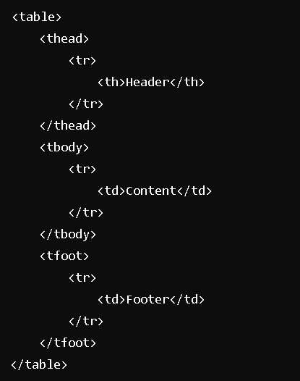
Basic Table Structure
Use <table> tag to define a table
Use <tr> to define a table row
Use <td> to define a table cell
Use <thead> for table headers
Use <tbody> for table body content
Use <tfoot> for table footers

Slide 15
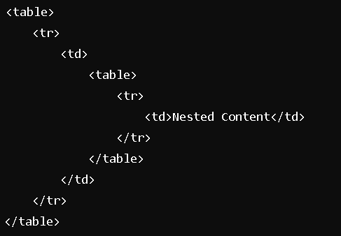
Nesting Tables
Use nested <table> tags within <td> elements for complex layouts
Ensure proper closing of each table
Helps manage complex designs by compartmentalizing sections
Useful for creating sections like sidebars or multiple columns
Facilitates independent styling of nested tables

Slide 16
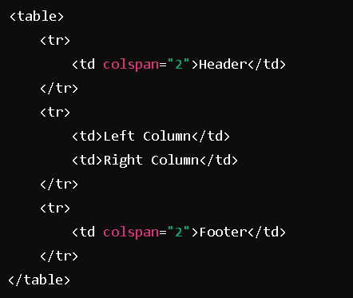
Creating Complex Layouts with Tables
Combine multiple rows and columns for complex designs
Use colspan to merge cells horizontally
Use rowspan to merge cells vertically
Create multi-column layouts within a single row
Ensure alignment and consistent spacing
Maintain a clear and organized structure for readability

Slide 17
Typography in Email Design

Slide 18
Best Fonts for Emails
Use System Fonts:
Arial
Verdana
Georgia
Benefits:
High compatibility across different email clients
Fast loading times
Considerations:
Limited design options
Can look different on various devices

Slide 19
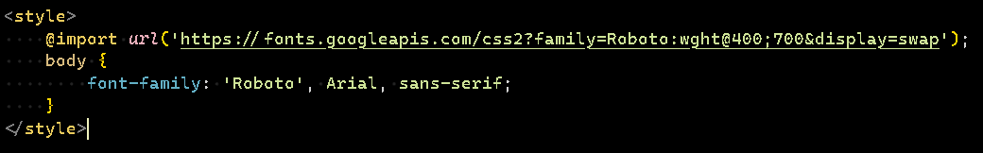
Web Fonts
Advantages:
Greater design flexibility
Enhanced visual appeal
Popular Web Fonts:
Google Fonts
Adobe Fonts
Implementation:
Import web fonts in email HTML
Include fallback system fonts

Slide 20
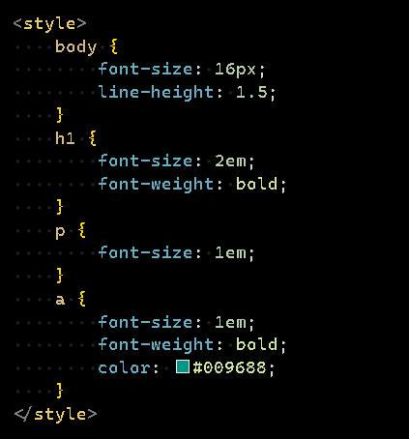
Font Sizes and Styles
Relative Units:
Use em and rem for scalable text
Hierarchy:
Clear differentiation between headings, subheadings, and body text
Styles:
Use bold and italics sparingly

Slide 21
Ensuring Readability
High Contrast
Maintain contrast between text and background
Use dark text on light background or vice versa
Font Size
Minimum 14px for body text
Larger sizes for headings
Line Spacing
1.5 line height for readability
Font Styles
Avoid excessive bold and italics
Readability Considerations
Use whitespace effectively
Avoid all caps
Limit paragraph length
Accessibility
Use semantic HTML
Test with color contrast checkers

Slide 22
Interactive Elements in Emails

Slide 23
Buttons and CTAs
A prompt that encourages the recipient to take a specific action.
Importance of CTAs:
Encourage user actions
Increase click-through rates
Best Practices:
Use clear and concise text (e.g., "Buy Now", "Learn More")
Make buttons visually distinct
Ensure buttons are large enough to be tapped on mobile devices
Design Tips:
Use contrasting colors for text and background
Include hover effects to enhance user experience
Position CTAs prominently within the email
Use whitespace effectively to make CTAs stand out

Slide 24
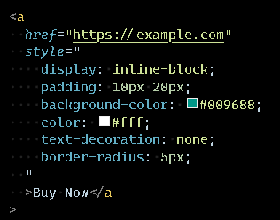
Accessibility:
Ensure sufficient color contrast
Provide descriptive link text for screen readers
Avoid relying solely on color to convey meaning
Testing:
Test buttons across different email clients
Ensure buttons work on both desktop and mobile devices

Slide 25
Forms in Emails
Purpose:
Collect user data directly from the email
Limitations:
Not supported by all email clients
Test thoroughly before use

Slide 26
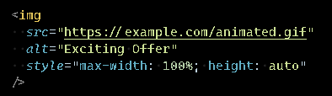
Incorporating GIFs and Animations
Benefits:
Capture attention
Convey information quickly
Best Practices:
Keep file sizes small for fast loading
Use animations sparingly to avoid distraction

Slide 27
Best Practices for Interactivity
General Tips:
Test interactivity across different email clients
Use fallback content for unsupported clients
Ensure accessibility for all users
Testing Tools:
Litmus
Email on Acid

Slide 28
Accessibility in Emails

Slide 29
Email Accessibility?
Email accessibility ensures that all users, including those with disabilities, can read and interact with email content.
Importance:
Compliance with legal standards (e.g., ADA, WCAG)
Wider audience reach
Improved user experience for everyone

Slide 30
Semantic HTML
Semantic HTML uses meaningful tags that convey the structure and meaning of the content.
Benefits:
Improves screen reader compatibility
Enhances SEO
Easier to maintain and understand
Example of Semantic HTML
Use of headings (<h1>, <h2>, etc.)
Use of lists (<ul>, <ol>)
Use of landmarks (<header>, <nav>, <main>, <footer>)

Slide 31
ARIA Labels
ARIA (Accessible Rich Internet Applications) labels provide additional context for screen readers.
Provides textual descriptions to user interface elements.
Enhances accessibility for screen reader users.
Allows developers to add descriptions where HTML lacks native support.
Example of ARIA Labels:
aria-label=“close”
aria-labelledby=“dialog-title”
aria-describedby=“dialog-description
Benefits of ARIA Labels:
Improves accessibility for users with disabilities.
Enhances the user experience for screen reader users.

Slide 32
Color Contrast and Readability
Ensure sufficient contrast between text and background
Use tools to check contrast ratios (e.g., WebAIM)
Avoid color combinations that are difficult to read
Examples:
Dark text on a light background
Light text on a dark background
Avoiding color clashes

Slide 33
Personalization and Dynamic Content in Emails

Slide 34
Importance of Personalization
Enhanced Engagement:
Higher open and click-through rates
Relevant and tailored content
Improved Customer Experience:
Makes customers feel valued
Better overall email experience
Increased Conversion Rates:
Personalized product recommendations boost sales
Dynamic offers drive purchases
Building Customer Loyalty:
Fosters deeper brand connection
Encourages customer loyalty

Slide 35
Using Merge Tags
Placeholders replaced with recipient-specific information
Examples:
{{FirstName}} for recipient's first name
{{LastPurchase}} for last purchase data
How to Use:
Insert merge tags in email content
Ensure email list includes necessary data

Slide 36
Dynamic Content Blocks
Sections that change based on recipient data or behavior
Benefits:
Tailors content to individual preferences
Increases relevancy and engagement
Implementation:
Define rules for displaying content
Use email platform's tools for management

Slide 37
Testing Personalized Emails
Why Test?:
Ensure correct display of merge tags and dynamic content
Fix issues before sending
How to Test:
Send test emails to yourself and colleagues
Use preview tools to check different recipients
Tools and Platforms:
Mailchimp: Merge tags and dynamic content
HubSpot: Personalization and testing features
SendGrid: Dynamic content and analytics

Slide 38
Best Practices for Personalized Emails
Keep Data Updated:
Ensure recipient data is accurate
Segment Your Audience:
Group by interests, behavior, demographics
Respect Privacy:
Use data responsibly, comply with regulations
Monitor Performance:
Review analytics to measure impact

Slide 39
Best Practices and Future Trends

Slide 40
Best Practices for HTML and CSS in Emails
Use Table-Based Layouts:
Ensure compatibility with various email clients
Maintain structure and formatting
Inline CSS:
Style directly within HTML elements
Improve rendering in different email clients
Responsive Design:
Use media queries for mobile optimization
Adjust font sizes, images, and layouts for different screen sizes
Alt Text for Images:
Provide context when images fail to load
Improve accessibility
Limit External CSS and JavaScript:
Enhance email loading speed
Avoid potential blocking by email clients

Slide 41
Best Practices for HTML and CSS in Emails (Continued)
Font Choices:
Use web-safe fonts for consistency
Consider custom fonts with fallback options
Optimized Images:
Compress images to reduce load times
Use responsive image techniques
Testing Across Clients:
Test emails in various clients and devices
Use tools like Litmus or Email on Acid

Slide 42
Avoiding Common Pitfalls
Avoid Large Files:
Keep emails lightweight for faster loading
Limit use of heavy images and multimedia
Complex CSS Techniques:
Avoid advanced CSS not supported by email clients
Stick to basic styling for better compatibility
Excessive Use of Inline Styles:
Balance between necessary inline styles and clean code
Maintain readability and manageability of HTML
Not Including a Plain Text Version:
Ensure a plain text alternative for better deliverability
Enhance accessibility for all recipients

Slide 43
Avoiding Common Pitfalls (Continued)
Incorrect Use of Links:
Ensure all links are functional and correctly formatted
Avoid JavaScript-based links
Ignoring Accessibility:
Use ARIA roles and labels
Ensure sufficient color contrast
Poor Mobile Optimization:
Design for touch interactions
Use larger buttons and readable fonts

Slide 44
Future Trends in Email Design
Interactive Emails:
Use AMP for email for interactive elements
Include carousels, accordions, and forms
Personalization:
Leverage data to create personalized content
Use dynamic content blocks
Dark Mode Support:
Design with dark mode in mind
Test emails in dark mode environments
AI and Machine Learning:
Use AI for predictive content and send times
Implement machine learning for content optimization

Slide 45
Future Trends in Email Design (Continued)
Minimalist Design:
Focus on clean and simple designs
Reduce clutter for better user experience
Micro-Animations:
Use subtle animations for engagement
Ensure animations do not impact email performance
Voice Assistants:
Optimize emails for voice assistant reading
Include structured data for better interpretation

Slide 46
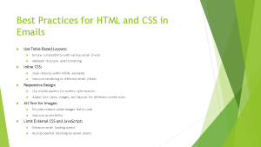
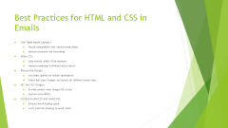
Continuous Learning Resources
Blogs and Articles:
Litmus Blog
Email on Acid Blog
Webinars and Workshops:
MarketingProfs Webinars
Email Design Conference
Communities and Forums:
Reddit: r/EmailMarketing
Stack Overflow: HTML/CSS for Emails

Slide 47
Continuous Learning Resources (Continued)
Books:
"Email Marketing Rules" by Chad S. White
"Designing for Email" by Kevin Mandeville
Tools and Software:
Litmus for Email Testing
Mailchimp for Email Design and Sending
Newsletters:
Really Good Emails Newsletter
Email Newsletter from Campaign Monitor

